Slide 1
Matthew, Nicole, Marie

Slide 3
Where it started
Introductions: If you would like, please put your name and institution into the chat window
Also in your chat window is a PDF handout
Link to the site: https://lww.trubox.ca/
So that you know … there is a dinosaur hiding in the website. If you find it, share your success in the chat window.
Where did Learning without Walls start?
Summer of 2020 (authentic, engaging & personal student experience)
Gaining momentum
Creative chaos (information, organizing, re-organizing, more information – Faculty of Student Development – organizing again)

Slide 4
Graphic design and technical functionality
Imagery, iconography and interaction
Making Moodle less Moodle-yyy
Mobile friendly WordPress

Slide 5
How it continued
Many voices - Faculty of Student Development (FSD), Thompson Rivers University Student Union (TRUSU), Open Learning (OL), Marketing and Communication)
Collaborative efforts (getting the word out)
It’s about students (feedback tool, sharing the future, students as partners)
Usage (Moodle and WordPress – why and how)

Slide 6
Let’s go for a tour
Here is the Moodle space
And the WordPress space

Slide 7
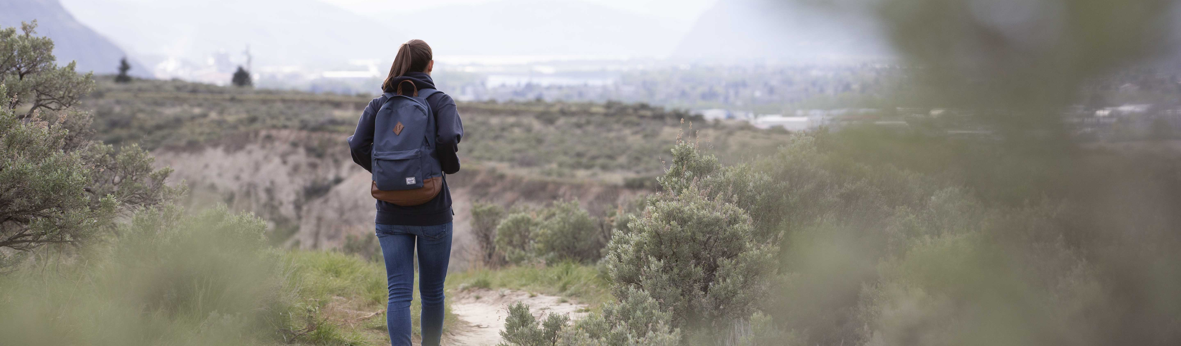
The survey
We would appreciate if you gave us feedback by filling in our survey: https://lww.trubox.ca/feedback-survey/

Slide 8
Discussion – Evolution
Questions, please!

Slide 9
Thank you
Send us your thoughts and ideas:
Matthew: mstranach@tru.ca
Nicole: nsingular@tru.ca
Marie: mbartlett@tru.ca

